Slide 1
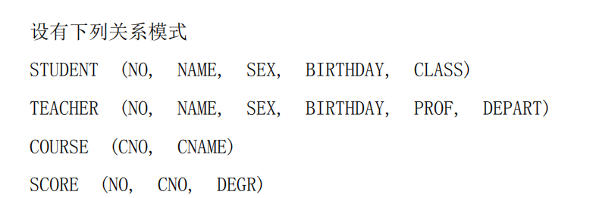
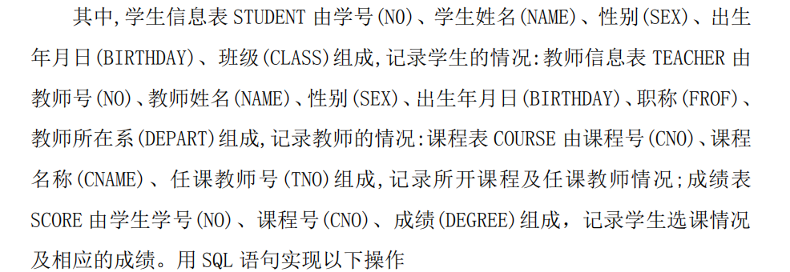

Slide 2
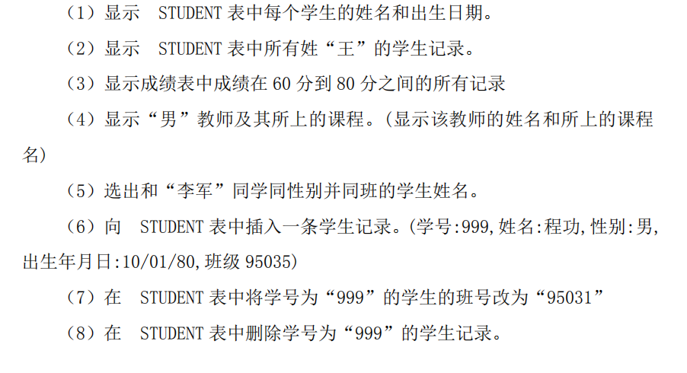

Slide 3
1.select name, birthday from student;
2.select * from student where name like ‘王%’；
3.select * from score where degree between 60 and 80;
4.select t.name,c.cname from teacher t
course where c.tno=t.no and t.sex=‘男’
5.select name from student where sex=(select sex from student where name=‘李军’) and class=(select class from student where name =‘李军’)
6.insert into student values(‘999’,’程功’,’男’,10/01/80,’95035’);
7.update student set class=’95031’ where no=‘999’;
8.delete from student where no=‘999’;

Slide 4
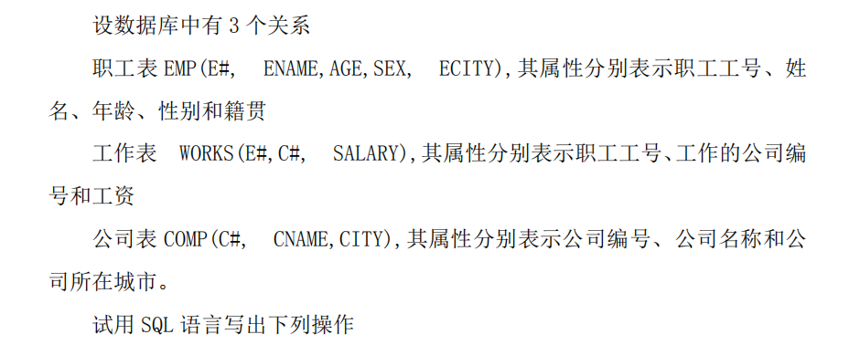

Slide 5
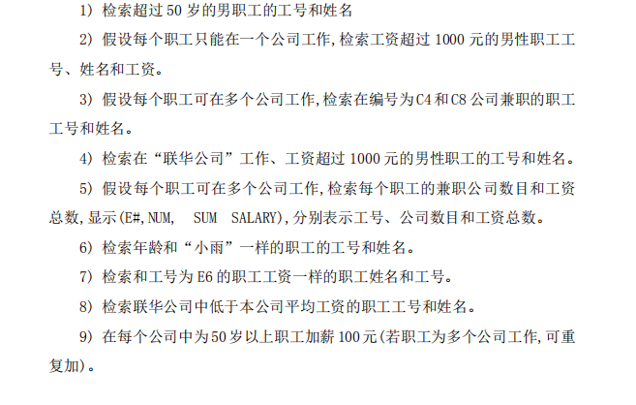

Slide 6
1.SELECT E#,ENAME FROM EMP WHERE AGE > 50 AND SEX='M';
2. SELECT E.E#,E.ENAME,W.SALARY FROM EMP E, WORKS W WHERE W.E#=E.E# AND E.SEX=’男’ AND W.SALARY>1000;
3. SELECT A E#, A enAme FROM EMP A, WORKS B, WORKS C
WHERE A.E#=B.E#ANDB.E#=C.E#ANDB.C#'C4' AND C.C#='C8'
4.SELECT A E#, A ENAME FROM EMP A, WORKS B, COMP C
WHERE A.E#=B.E#ANDB.C#=C.C# AND CNAME=‘联华公司
AND SALARY>1000 AND SEX='M'
5.SELECT E#,COUNT(C#),SUM(SALARY) FROM FWORKS GROUP BY E#;

Slide 7
6.SELECT E#,ENAME FROM EMP WHERE AGE=(SELECT AGE FROM EMP WHERE ENAME ='小雨');
7.SELECT E#,ENAME FROM EMP WHERE E# IN (SELECT E# FROM WORKS WHERE SALARY IN (SELECT SALARY FROM WORKS WHERE E#=’E6’ ));
8.SELECT E.E#,E.ENAME FROM EMP E INNER JOIN WORKS W ON W.E#=E.E# INNER JOIN COMP C ON C.C#=W.C# WHERE C.CNAME=’联华公司’ AND W.SALARY <(SELECT AVG(SALARY) FROM WORKS WHERE C# =(SELECT C# FROM COMP WHERE CNAME=’联华公司’));
9.UPDATE WORKS SET SALARY=SALARY+100 WHERE E#=(SELECT E# FROM EMP WHERE AGE>50)

